Slide 1
Nonlinear Dynamical Systems Workshop
Wednedsay Afternoon

Slide 2
Overview (1:30)
State Space Grids
Research Design and State Spaces
Catastrophe Theory
Origin of Catastrophes
Catastrophe Flags
Modeling with Catastrophes
Theorizing with Catastrophes

Slide 3
Complex Systems Research Design (if time)
From our explorations so far, what do we learn about research design?
History – patterns – dynamics
What happened to the linear paradigm?
Idiographic vs. nomothetic (Molenaar, 2004)
Density of data, not powerful n
Far from equilibrium
Think in terms of research programs
Find dimensions from data
Theorize with that knowledge
Perform a new investigation

Slide 4
Research Design (if time)
Denser data rather than larger samples
Weave together trajectories to make a “manifold” (arbitrary shape)
What about samples and randomization?
Answer: We don’t care!
Different research subjects have different trajectories but the same dynamics, which are due to “traveling” on the same manifold
Lose some ability to compare groups
Ah…the RCT thing is still needed for comparing
See Royall (1997)

Slide 5
State Space Grids (1:00)

Slide 6
State Space Grids (SSG) (1:00)
Categorical time series data
Categories on the axes, not time series
Focus on the categories, not the time
Example: NDSMacro1
ssg(pull(read.csv("https://bit.ly/NDSMacro1")))
ssg_metrics(pull(read.csv("https://bit.ly/NDSMacro1")))
Ugh…choose only some of the values

Slide 7
CYO SSG (1:15)
Use these data or your own
NDSMacro2
NDSTeacher1 (from Heleen Pennings)
NDSTeacher2 (from Heleen Pennings)
Discussion
Compare NDSMacro2 to NDSMacro1
Compare NDSTeacher1 to NDSTeacher2
Compare SSG results to RQA results

Slide 8
Complex Systems Research Design (1:45)
From our explorations so far, what do we learn about research design?
We’ll look at theorizing tomorrow & Friday
History – patterns – dynamics
What happened to the linear paradigm?
Manifolds and trajectories
Idiographic vs. nomothetic (Molenaar, 2004)
Far from equilibrium
Density of data, not powerful n

Slide 9
Research Design (2:00)
Denser data rather than larger samples
Weave together trajectories to make a “manifold” (arbitrary shape)
What about samples and randomization?
Answer: We don’t care!
Different research subjects have different trajectories but the same dynamics, which are due to “traveling” on the same manifold
Lose ability to compare groups
Ah…the RCT thing is still needed for comparing!
See Royall (1997)

Slide 10
Hysteresis (2:15)
Attractor Demonstration
Notice: Hysteresis – transitions happen at different parameter values, depending upon the direction of the transition
This is a radical idea in almost all areas of theorizing
Notice: Multi-stability in the horizontal direction
Can be a cause of bimodal (or multimodal) data
This is an equilibrium demonstration; it is easier to talk about that way
It applies to nonequilibrium situations too

Slide 11
Catastrophes (2:25)
Multi-stability
Same IV, but different DV
History dependent multi-stability (hysteresis)
Put together and you can get sudden changes (a.k.a., “catastrophes”)
Formalizes and extends “covariates”
Different trajectories (more in a few minutes)
E.g, People who have experienced previous trauma behave differently from people who have not
Covariate (as a possession) vs. history (as a process)
Notes:
“Well, how did I get here?”

Slide 12
Catastrophe Flags (2:35)

Slide 13
Recognizing Catastrophes in Data (2:35)
Many of these apply to those data sets you happen to see laying around
Caution: Once you start seeing catastrophes, it’s hard to not see them
That will wear off the more you think clearly about covariates and histories
Eight Catastrophe Flags (Gilmore, 1981)
Modality • Divergence
Inaccessibility • Response divergence
Discontinuity • Critical slowing down
Hysteresis

Slide 14
Practical Flags (2:40)
Although not a perfect approach, there are three features of data distributions that, if you see them, may warrant further investigation as catastrophe.
Dents (or tendrils)
Holes
Notches
Certainty about this requires rather dense data and a model fit
These are related to four of Gilmore’s (1981) flags
We’ll see examples of the other flags later
Notes:
As usual, a scatterplot can be helpful. Related to Gilmore’s inaccessibility flag, there are patterns in data (or rather, lack of data) that may tip one off to the presence of catastrophes.

Slide 15
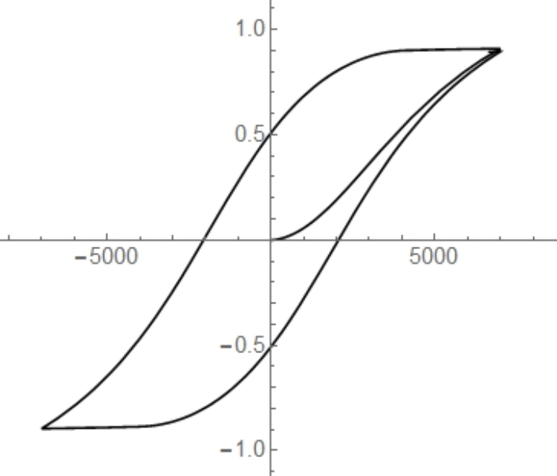
Dents
Dents in the data (compared to elliptical scatterplot)
Most scatterplots are more elliptical
Related to Gilmore’s (1981) modality, hysteresis, and inaccessibility flags

Slide 16
Dents…or tendrils
Can also think of these as tendrils on either end of the (elliptical) distribution
Related to Gilmore’s (1981) modality, hysteresis, and inaccessibility flags

Slide 17
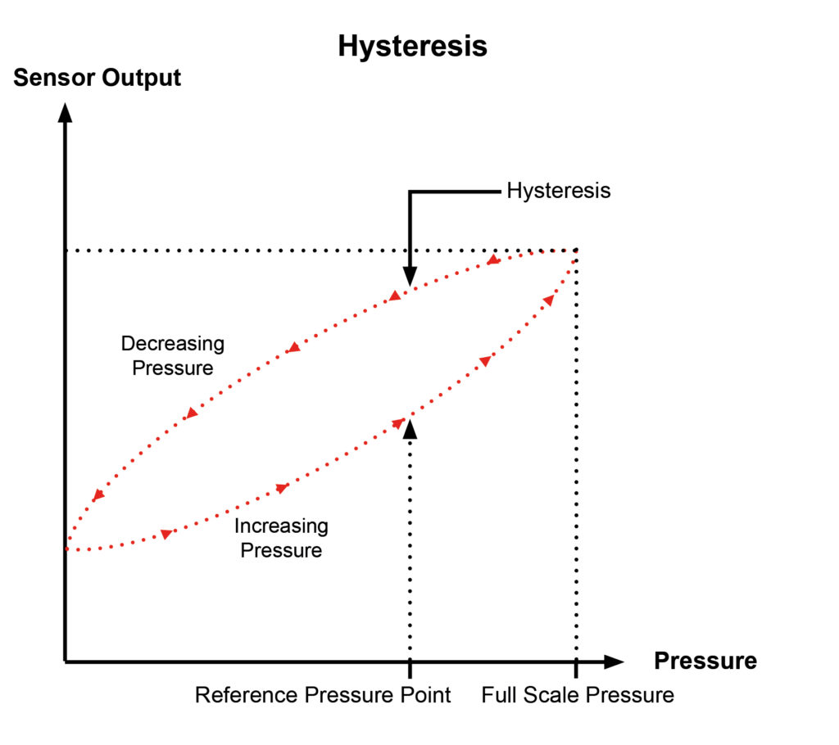
Holes
Hole in the data due to hysteresis
Really, there are two datasets:
One increasing (blue)
One decreasing (orange)
Related to Gilmore’s (1981) modality, hysteresis, and inaccessibility flags
Cardan’s discriminant

Slide 18
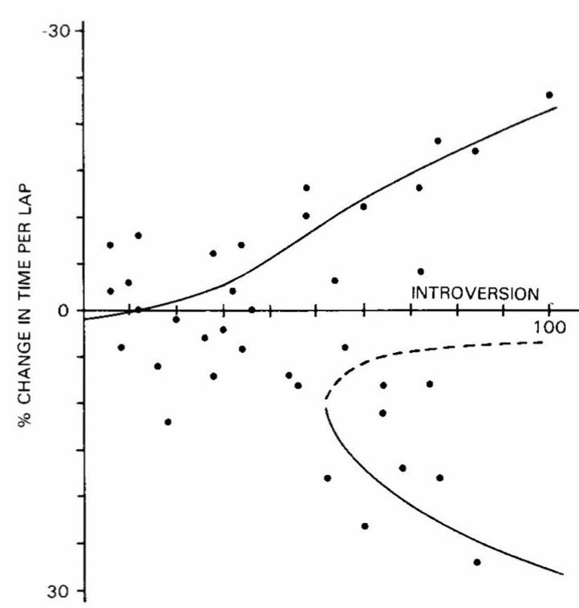

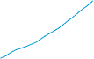
Notches
Heteroscedastic data
Notch starting to form on the right.
Related to Gilmore’s (1981) discontinuity & divergence flags
Notch
Notes:
Notice: The data are heteroscedastic (as introversion increases, so does the range of data) AND there appears to be the start of a notch on the right side.
This figure is from Cobb (1981).

Slide 19
Example Flag Search (2:50)
NDSCusp1
Political attitudes from van der Maas et al. (2003):
“The government must force companies to let their workers benefit from the profit as much as the shareholders do”
Outcome: Attitude toward what government should do
Asymmetry: Political orientation
Bifurcation: Political involvement (+ political orientation)

Slide 20
CYO (3:00)
Look for flags in these sets
NDSCusp2
Bifurcation:
Asymmetry:
Response:
NDSCusp3
Bifurcation:
Asymmetry:
Response:

Slide 21
Elementary Catastrophes (2:45)

Slide 22
Catastrophe Theory (2:45)
A branch of algebraic topology
Classification of critical points
Yes, these are the critical points of calculus, for those of you who had some of that.
Relate critical points to the topology of the “manifold”
Seven “elementary” [sic] catastrophes
Controversies
Application to social sciences were over-hyped
Computation methods not settled

Slide 23
Elementary Catastrophes (2:50)
Seven “elementary” catastrophes
Four cuspoids – fold, cusp, swallowtail, butterfly
1 outcome variable (DV) and 1 to 4 control parameters (IV)
Our focus today; the rest are just more math and more variables
Three umbillic – wave crest, hair, mushroom
2 outcome variables (DV) and 3 or 4 control parameters (IV)
Non-elementary
All of these are 5 or more variables
Start by approaching these as multiple elementary catastrophes, using only some of the variables for each model.
If those all work, then move to the full model. (Good luck!)

Slide 24
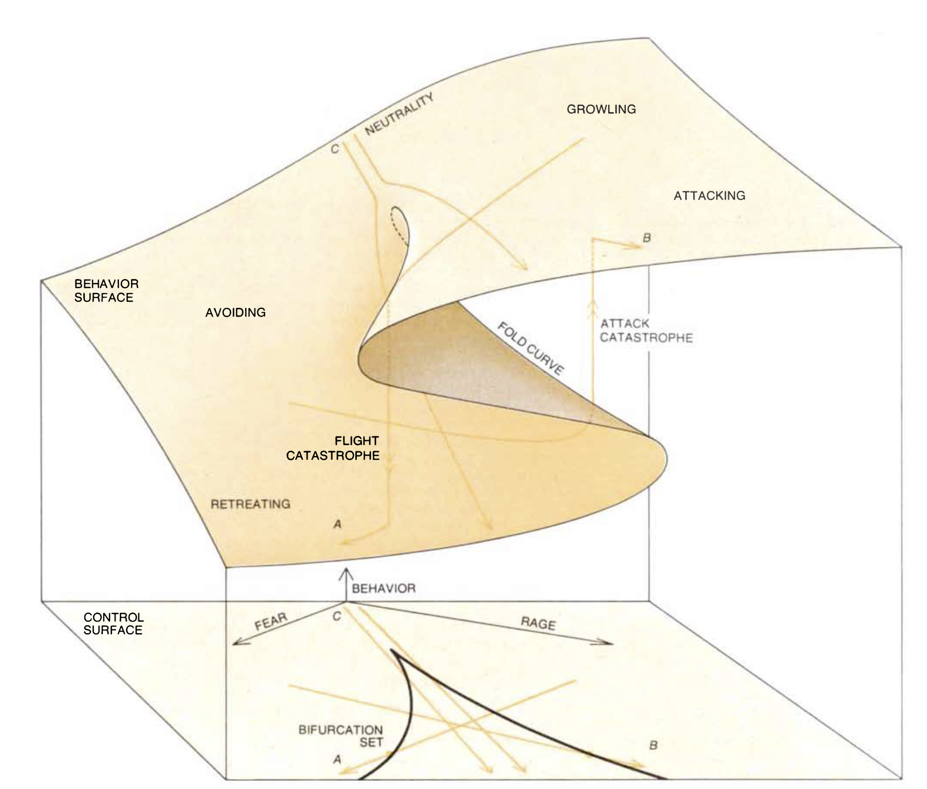
Fight or Flight: An archetype (2:55)
Notes:
Here is a classic cusp catastrophe, due to Zeeman (1976), which is both insightful and wrong. (Yes, we know it is wrong, so all the animal behavior people out there can just refrain from yelling at me.) Let’s spend a little bit of time with it:
Control surface vs. behavior surface
Notice that movement along the bifurcation axis produces a single pitchfork bifurcation (divergence of nearby points). Movement along the asymmetry parameter produces hysteresis; size of the hysteresis depends upon the value of the bifurcation parameter
Control axes (rage and fear) and behavior surface (????). Notice that this puts “fight” and “flight” on the same axis. Some confusion of the qualitative behavior and the quantitative output.
Look at the four paths in the control surface, and what their output behavior is.
Look at the “bifurcation set”
Notice that a cross section of the behavior surface (left-right) looks like, yep, the hysteresis
Bifurcation parameter (fear-rage) vs. asymmetry parameter (fear + rage): small bifurcation = no hysteresis; large bifurcation = hysteresis
Incidentally, the cusp is named for the point where the two branches of the bifurcation set meet; the “slope” is undefined there, and hence is a singularity. Catastrophe theory is an outgrowth of singularity theory
Delays…Maxwell convention, etc. See Gilmore

Slide 25
Cusp Catastrophe: A Closer Look (3:30)
Two parameters: asymmetry, a, and bifurcation, b
Bifurcation parameter
Small b: no hysteresis
Larger b: hysteresis
Notice, the amount of hysteresis (a.k.a., stuckness, irreversibility) due to a change in the asymmetry parameter depends upon the value of the bifurcation parameter
Often, we think about the bifurcation parameter moderating the asymmetry parameter, but classical moderation isn’t quite the whole story
Rotation of variable axes into control parameters may be needed

Slide 26
Modeling with Catastrophes (3:40)
Three Types of Datasets
Cross-sectional with 1 data point per subject
Cross-sectional with 2 time-series data points per subject
Cross-sectional with time-series trajectories for each subject
Debates
Technical debates about how each of these are used or can be used
Ignore the debates…the package deals with the issues
But be careful
End result: More times are better.
I.e., the trajectory version is the best data set to use

Slide 27
Cusp Example (3:45)
NDSCusp1
van der Maas et al. (2003)
Data:
Outcome: Attitude toward what government should do
Asymmetry: Political orientation
Bifurcation: Political involvement (+ political orientation)
Their approach, although I respect van der Mass a lot, is a bit iffy…

Slide 28
Cusp Example: Cod population (if time)
Sguotti et al. (2019)
Thorough methodology
NDSCusp2

Slide 29
Wrapping Up (3:55)
Please take the three-question survey
Give one good thing about today’s sessions
Give one thing that could have improved today’s sessions
One thing from the first three days’ sessions that we should examine more deeply (e.g., because you don’t understand it, or because you have an idea you want to explore, or whatever)
https://bit.ly/WednesdaySurvey

